Slide 1
Healthcare Patient & Encounter Analytics
Clinical Data Quality, Healthcare Utilization & Predictive Analytics
Jayashree Kanukollu
Clinical Quality Analyst — Work Sample
Tools: MySQL | Microsoft Excel | Power BI | Python
Data Sources: Synthea Synthetic Healthcare Data and CMS Medicare Part D Public-Use Data

Slide 2
Healthcare Business Problem & Objectives
Business Problem
Limited visibility into healthcare utilization, claim costs, and encounter documentation completeness.
Need to transform complex healthcare records into actionable insights for operational decision-making.
Project Objectives
Validate data quality and analyze utilization and costs.
Apply statistical models, develop interactive dashboards, and propose improvements.
Expected Outcome
A reproducible, stakeholder-friendly analysis supporting healthcare data quality monitoring and operational decision-making.

Slide 3
Dataset Description & Analytical Workflow
PATIENTS
108
DATA SOURCE
Synthea
ENCOUNTERS
5,571
EXCEL
Data Validation
MYSQL
Analysis
POWER BI
Dashboards
PYTHON
Statistics & ML
Synthetic patient and encounter data — no real PHI

Slide 4
Data Cleaning & Validation Findings
Key Data Quality Finding
36.7%
2,044 encounters with missing reason descriptions
Wellness 1,254
Outpatient 393
Data Integrity Checks
108 patients, 5,571 encounters
0 duplicate IDs
0 unmatched patient references
0 invalid encounter date sequences
0 missing or nonpositive claim costs
Review documentation requirements by encounter type and monitor reason-description completeness before classifying blank values as errors.

Slide 5
Healthcare Utilization & Claim Cost Analysis
5,571
Total Encounters
$16.81M
Total Claim Costs
$3.02K
Average Claim Cost
Healthcare Utilization
Ambulatory – 2,939 encounters
Wellness – 1,262 encounters
Outpatient – 759 encounters
Claim Costs by Encounter Type
Ambulatory - $12.82M
Wellness - $1.21M
Outpatient - $0.97M
Key Finding :Ambulatory visits accounted for approximately 52.8% of encounters and 76.3% of total recorded claim costs, making them a priority for further cost-driver analysis.

Slide 6
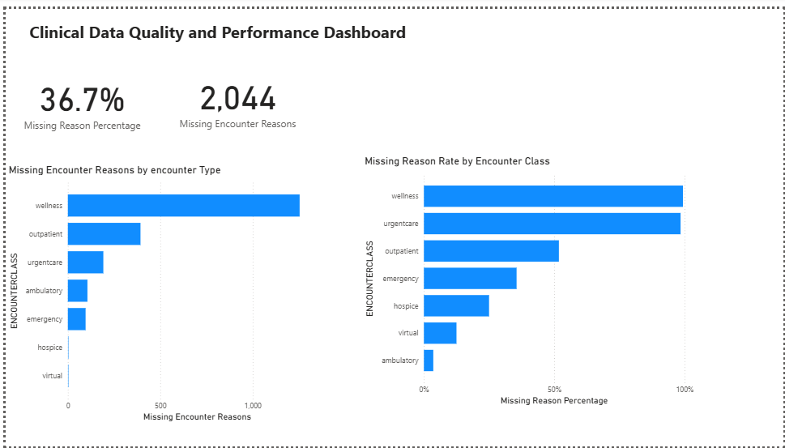
Clinical Data Quality Dashboard
Interactive functionality: Users can filter by encounter class and examine missing-reason counts and percentages to support targeted data-quality monitoring.
Key finding : Missing encounter reason descriptions are concentrated in wellness and outpatient records. Documentation requirements should be reviewed before classifying missing values as errors.

Slide 7
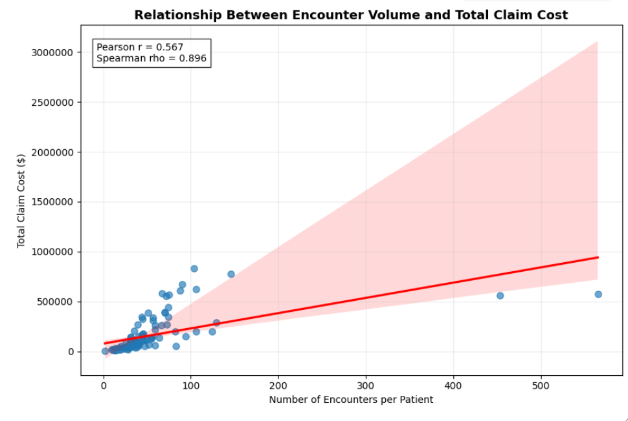
Correlation Analysis & Outlier Detection
Key findings : Higher encounter counts were associated with greater total claim costs, but cost variation and extreme observations indicate that utilization alone does not explain spending.
Pearson r = 0.567 - moderate positive linear association
Spearman ρ = 0.896 - strong positive monotonic association
5 of 108 patients (4.6%) exceeded the IQR threshold of 106.5 encounters.

Slide 8
Predictive Modeling & Model Evaluation
Linear Regression
0.4648
Test R²
MAE: $87,283.70
RMSE: $104,412.94
CV mean R²: 0.2160
Random Forest
0.7781
Test R²
MAE: $40,374.57
RMSE: $67,232.69
CV mean R²: 0.5974
Key finding :Random Forest demonstrated lower prediction errors and higher R² across the held-out test and five-fold cross-validation evaluations.
Limitation :Exploratory retrospective analysis of 108 synthetic patients; results are not validated for future-cost forecasting

Slide 9
Medicare Part D Predictive Analytics
Group Capstone Project | Use Case 2: High-Cost Classification
Project Overview
Source: CMS Medicare Part D Public-Use Data
Period: 2017–2023
Dataset: Approximately 800,000 records
Objective: Classify high-cost drug-spending observations to support resource prioritization.
Predictive Modeling – Imputed Dataset
Models: Logistic Regression and Random Forest
0.9930
Random Forest ROC-AUC
0.9346
Random Forest F1-score
Contribution & Analytical Value
Contributed to the team's high-cost classification use case, applying predictive analytics to explore Medicare drug-spending patterns and support data-informed resource prioritization.

Slide 10
Operational Recommendations & Conclusion
Operational Recommendations
1. Documentation quality: Review missing encounter reasons against visit-specific documentation requirements.
2. Cost monitoring: Investigate drivers of ambulatory claim costs.
3. Utilization monitoring: Review unusually high encounter volumes for operational patterns.
4. Ongoing reporting: Use interactive dashboards to monitor trends and data completeness
Study Limitations
Synthetic data: Findings do not represent actual hospital performance.
Sample size: Predictive analysis used only 108 patients.
Retrospective models: Completed encounter counts were used to estimate accumulated claim costs.
Validation: Models are not clinically validated for future-cost prediction.
Conclusion
Integrated Excel, MySQL, Power BI, and Python to demonstrate healthcare data validation, utilization analysis, clinical data quality monitoring, and exploratory predictive analytics.

